Slide 1
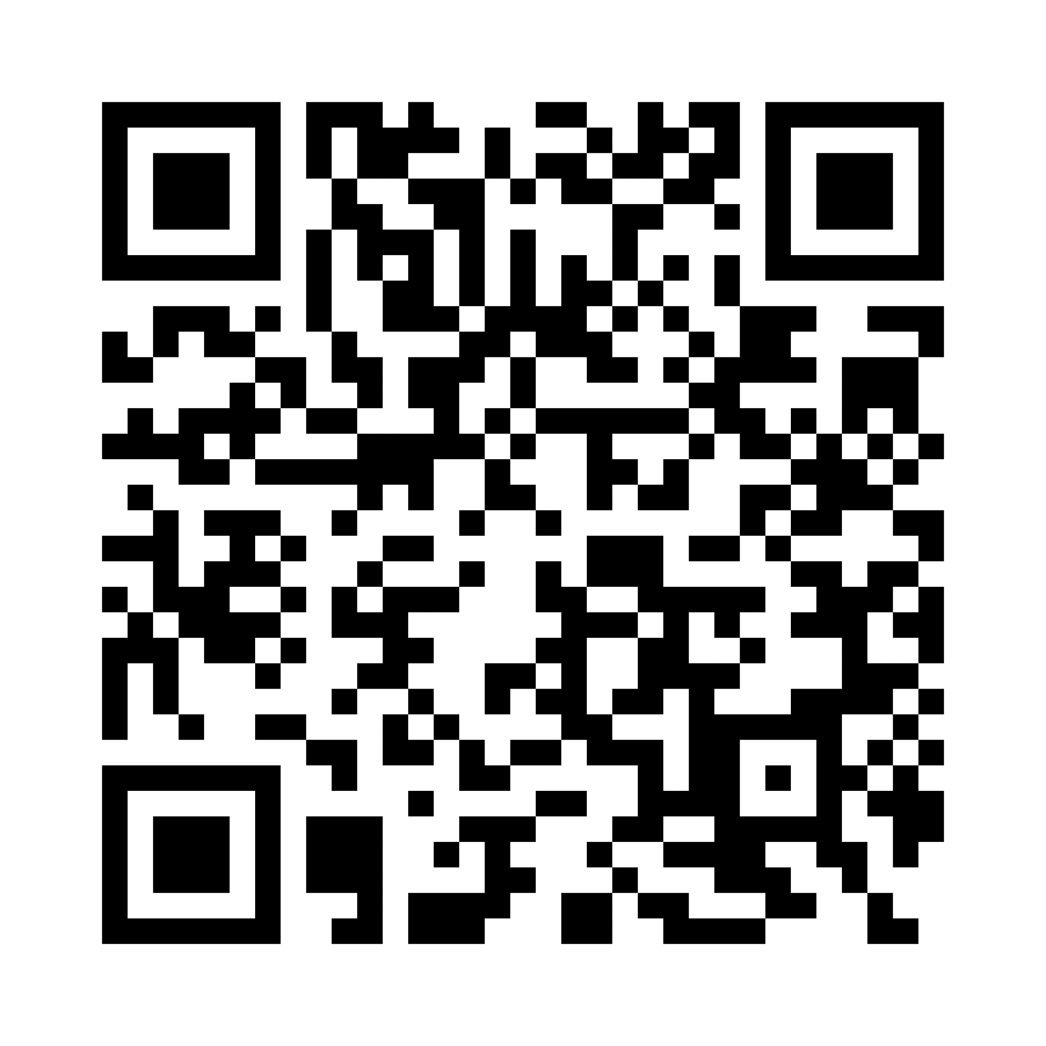
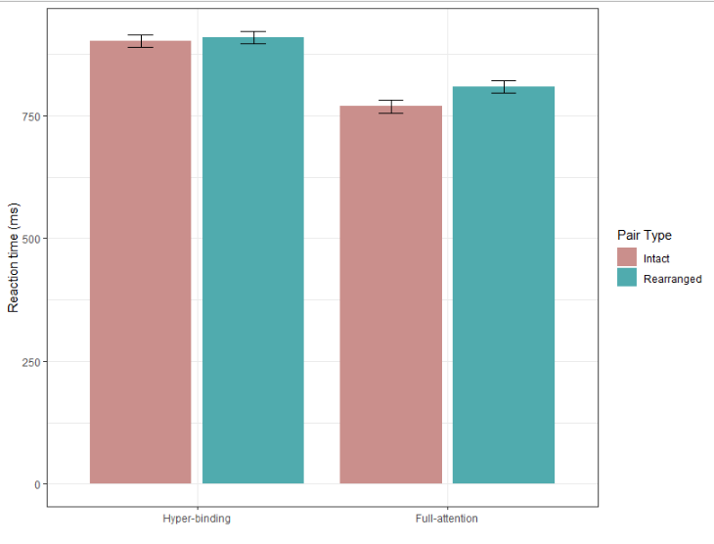
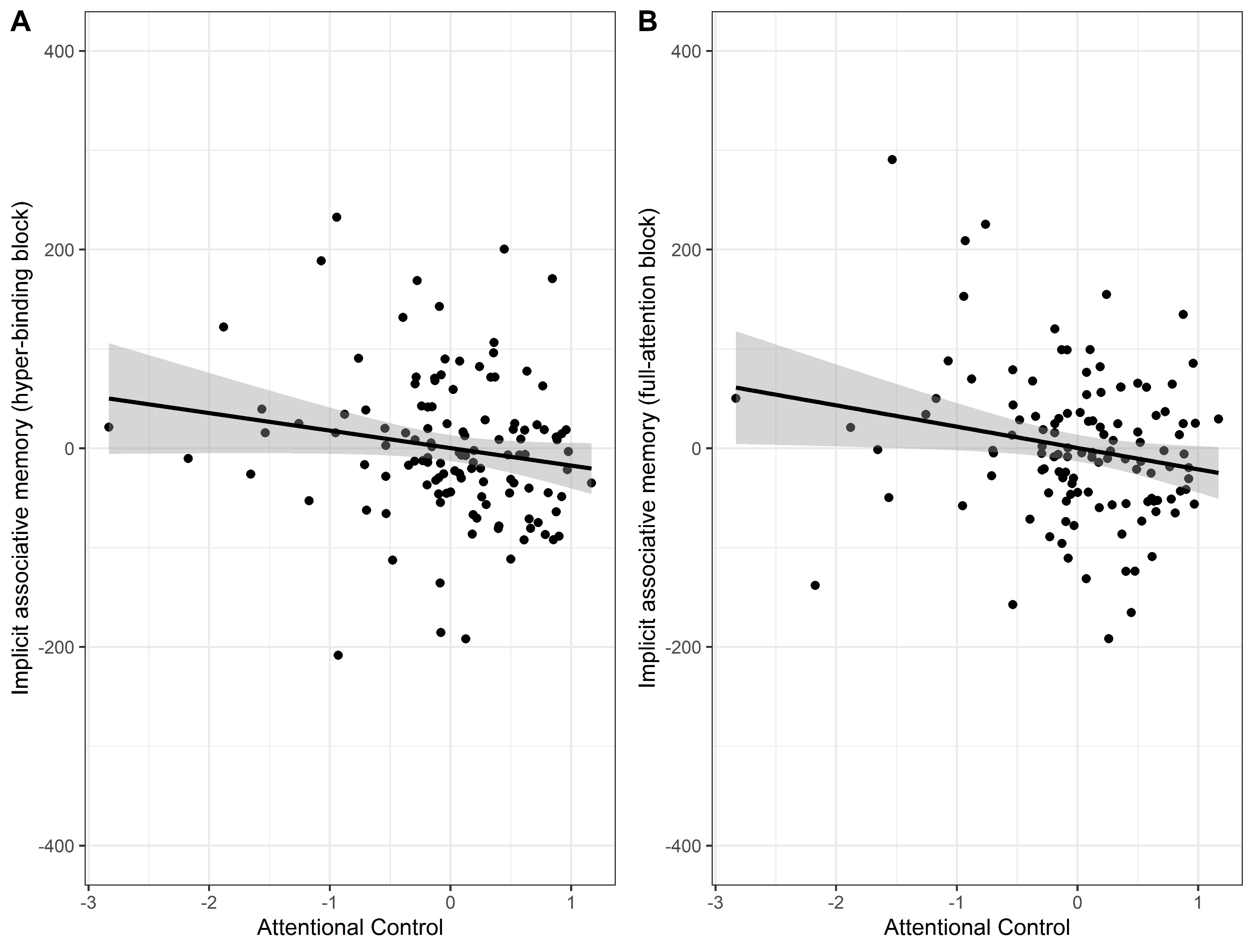
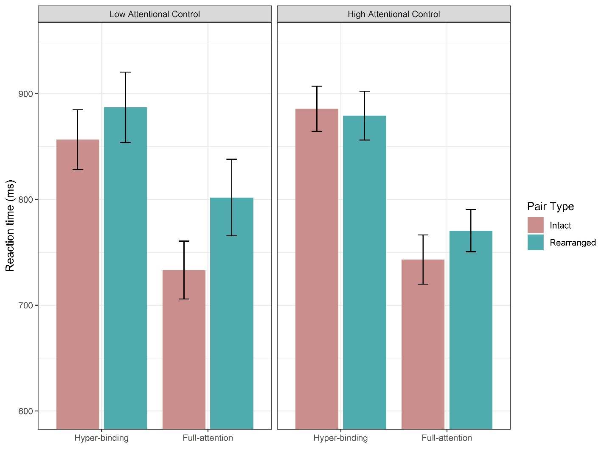
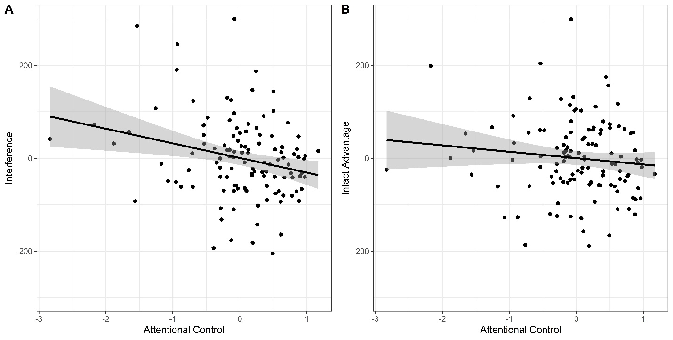
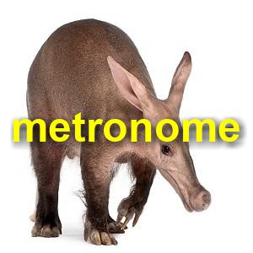
Poor attentional control relates to hyper-binding in a young adult sample
Emily E. Davis, Edyta K. Tehrani & Karen L. Campbell
Brock University, St. Catharines, Ontario, Canada
Pre-print: https://osf.io/preprints/psyarxiv/2um4s/
Background
Results
Hyper-binding - the erroneous encoding of both target and distractor information into associative pairs in memory - has been described as a unique age effect, caused by declines in attentional control (Campbell et al., 2010)
On average, young adults do not hyper-bind, even when explicitly alerted to the relevance of previously distracting information (Campbell & Hasher, 2018).
If hyper-binding and attentional control are linked, then young adults with poor attentional control should show evidence of hyper-binding, while those with relatively good attentional control should not.
Prediction: Hyper-binding will be negatively related to attentional control.
Implicit associative memory score: Residual of Regression: Rearranged = β0 + β1 intact.
Composite attentional control score: Average z-scores across tasks
**
Hyper-binding block
Full-attention block
Reaction Time (ms)
Implicit Associative Memory Score
Hyper-binding
Full-attention
ρ = -.216, p = .017
ρ = -.171, p = .062
Repaired > Intact in full-binding block (p < .001),
but not hyper-binding block (p = .508).
Attentional Control
Attentional Control
Attentional Control
Prediction supported: Poorer attention control relates to more hyper-binding
Method
Participants were split into four quartiles.
Attentional control predicted slower RTs to rearranged pairs (i.e., interference) in the full-attention block, but not priming of intact pairs.
N = 121
Lowest quartile (N=31) showed evidence of implicit associative memory in both blocks.
Highest quartile (N=31) showed evidence of implicit associative memory in only the full-attention block.
Implicit associative memory task developed by our lab (Davis et al., 2021).
Measures associative memory for both target-distractor and target-target pairs.
Hyper-binding Encoding
Hyper-binding Test
Full-attention Encoding
Full-attention Test
Low Attentional Control
High Attentional Control
**
Hyper-binding: Ignore word; “Can this pictured object fit inside of a desk drawer?”
Full-attention: Attend both;
“Can both of these objects fit together inside of a desk drawer?”
**
**
Interference
Priming
Reaction Time (ms)
Encoding
Test
ρ = -.228, p = .012
ρ = -.106, p = .251
Hyper-binding
Full-attention
Hyper-binding
Full-attention
Attentional Control
Attentional Control
Repaired (familiar items but repaired)
Discussion
Intact (same as encoding)
On average, young adults do not hyper-bind. However, our findings suggest that there is a link between hyper-binding and attentional control in younger adults.
Those with lower attentional control experienced more interference to rearranged items, but individual differences in attentional control do not seem to affect associative priming when both items are attended.
This work supports the inhibitory deficit theory of cognitive aging
Helps to better understand the cognitive mechanisms underlying hyper-binding and implicit associative memory.
Repaired RT > Intact RT = Implicit associative memory
Anti-saccade
Flanker
Stroop
Filtering working memory task
References
Campbell, K. L., Hasher, L., & Thomas, R. C. (2010). Hyper-binding: A unique age effect. Psychological Science, 21, 399–405.
Campbell, K. L., & Hasher, L. (2018). Hyper-binding only apparent under fully implicit test conditions. Psychology and Aging, 33, 176-181.
Davis, E.E., Foy, E.A., Giovanello, K.S., & Campbell, K.L. (2021). Implicit associative memory remains intact with age and extends to target-distractor pairs. Aging, Neuropsychology and Cognition, 28, 455-471.
Draheim, C., Tsukahara, J.S., Martin, J.D., Mashburn, C.A., & Engle, R.W. (2020). A toolbox approach to improving the measurement of attentional control. Journal of Experimental Psychology: General, 150, 242-275.
Draheim, C., Tsukahara, J.S., & Engle, R.W. (2022, October 22). Replication and extension of the toolbox approach to measuring attentional control. Psyarxiv.
Attentional control tasks developed by the Engle lab (Draheim, 2020; 2022)
Questionnaires: Awareness, vocabulary, demographics
Emily E. Davis, ed11zq@brocku.ca

